Slide 1

WebSchool4You
Mahsam

Slide 2

Introduction
This PowerPoint will cover the core structure of my E-Learning platform.
It will be able to showcase the problem, the design decisions, the functionality of the platform and the results.

Slide 3
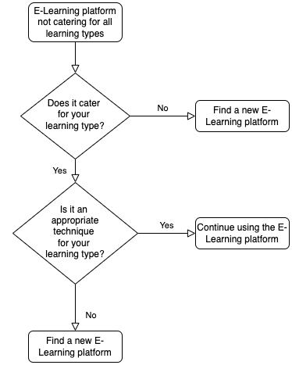
Defining the problem
Not every user’s learning type is catered for in an E-Learning platform.
The flowchart shows the number of users that will be deferred away from the website if their learning type isn’t accommodated for.
This made it vital to incorporate all learning types.

Slide 4

Aims & Objectives
The aim of the website was to ensure that the platform that was created would suit all users.
The objective was to have at least one learning technique for each type of learning available.

Slide 5
Literature Review
Existing solutions don’t cater for all learning types as shown from the table below.
The VARK model suggests we are either visual, auditory, reading and writing, kinaesthetic or multimodal learners.
A research study showed that users have a 66% multimodal preference.
Social integration is lost with E-Learning platforms.
Website | Reading and Writing | Visual | Kinaesthetic | Auditory
W3Schools | ✓ | ✗ | ✓ | ✓
Microsoft docs | ✓ | ✗ | ✗ | ✗
WebsiteSetup | ✓ | ✗ | ✗ | ✓
freeCodeCamp | ✗ | ✗ | ✗ | ✓
Khan Academy | ✗ | ✗ | ✗ | ✓

Slide 6

Design and Application Decision
The design was to ensure it was consistent and easy to navigate through.
There was text and books for reading and writing learners, videos for visual and auditory learners and games for kinaesthetic learners.

Slide 7
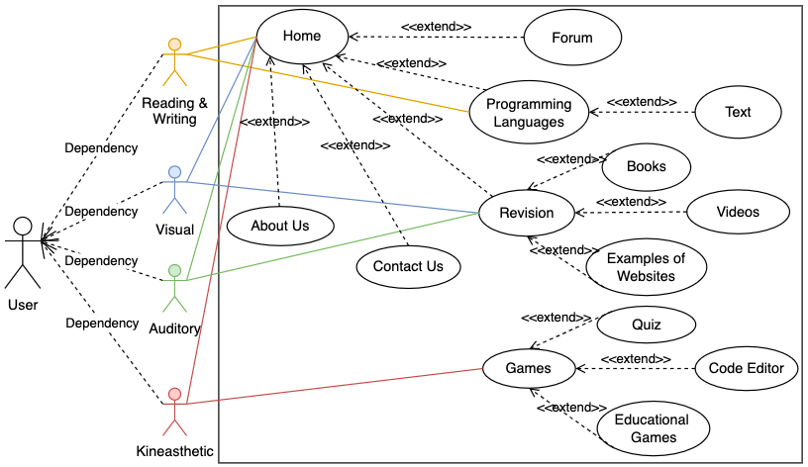
Implementation
The use case shows each learning type being catered for.
We can also see the different techniques that are offered to each learning type as well.

Slide 8
Demonstration

Slide 9
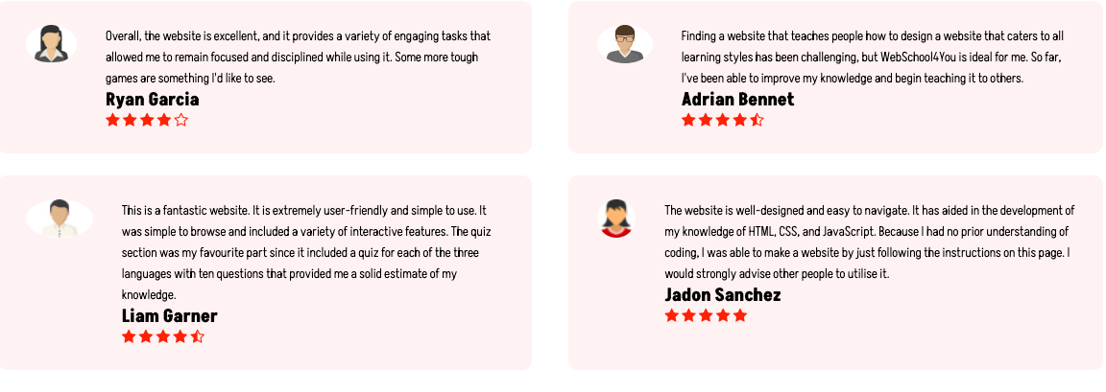
Results
After publishing the website online, there were numerous positive reviews that came.
There was positive feedback suggesting that the website was catering to all learning types
Notes:
https://github.com/Mahsam24/Website

Slide 10

Conclusion
To conclude, judging by the feedback the website was a success and it was able to solve the problem.
This website is one of the most versatile e-learning platforms that teaches all users how to create a website.
For future work, my website would include some more advanced games and a chatbot.

